Slide 1


P136 – Group 2 Diabetic Retinopathy Prediction in Patients
By-
Mrs. Gayatri Baseshanakr
Mrs. Samarthini
Mr. Prasad Balchandra Kyatham
Mr. Swaraj Vijaykumar Abruk
Mr. Saket Sharma
Mr. Saurabh Prakash Patil
Mr. Hritik Patole
Mentor
Mr. Varun Vennelaganti

Slide 2
Project Overview-
Data Collection
Data Preprocessing
EDA
Model Building
Deployment

Slide 3
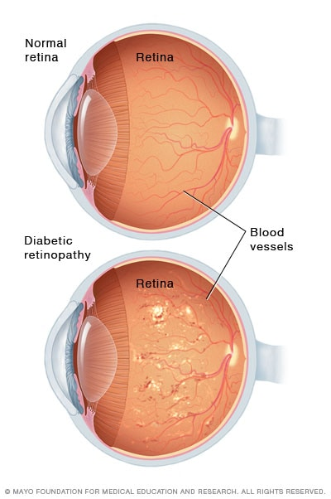
Introduction
Bussiness statement -
Diabetic Retinpathy Prediction in Patients
Bussiness Problem -
The variable to be predicted has two values (positive or negative on diabetic retinopathy). Thus, this is a binary classification project. The goal here is to predict whether a patient will suffer from diabetic retinopathy or not, conditioned on blood test features
Solution-
By using the classification models we can predict the outcome by considering the provided parameters

Slide 4
1. Data set Details
Target variables has two values in a classification project type: 0 (false) or 1 (true). The number of instances (rows) in the data set is 6000, and the number of variables (columns) is 6.
The following list summarizes the information of the variables.
1) ID: Numeric 2) age: (numeric).
3) systolic_bp: 120Hg
4) diastolic_bp: 80Hg
5) cholesterol: 125 and 200Hgdl
6) prognosis: (0 or 1) (Target). It is 1 if the patient has retinopathy and 0 if he doesn't.

Slide 5
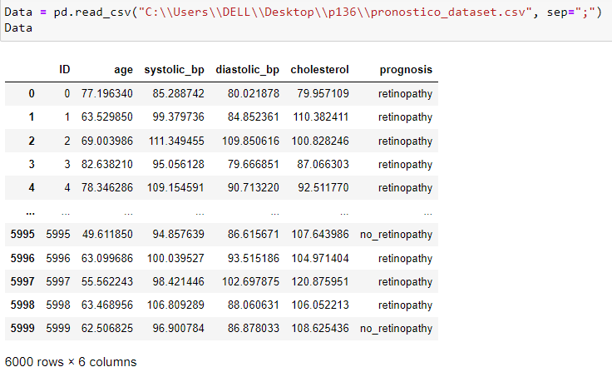
2. Data Set Collection

Slide 6
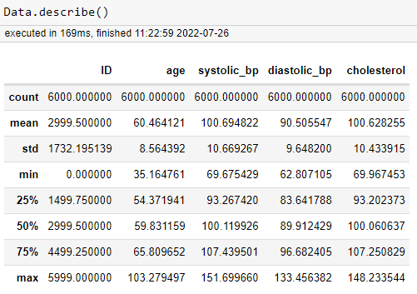
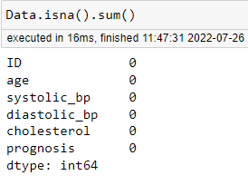
3. EDA Very first we have check whether data is missing or not
Description of data
There is no missing data.

Slide 7
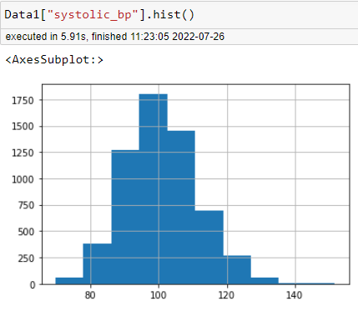
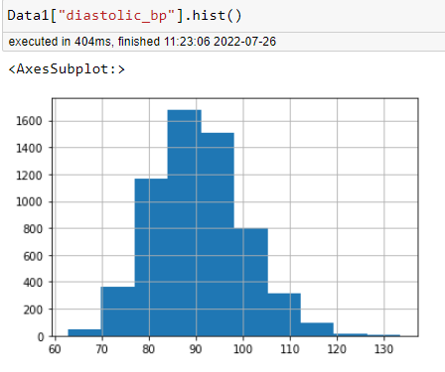
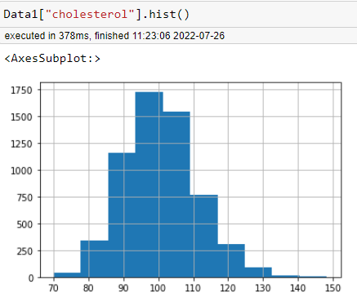
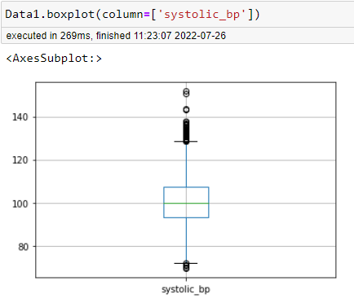
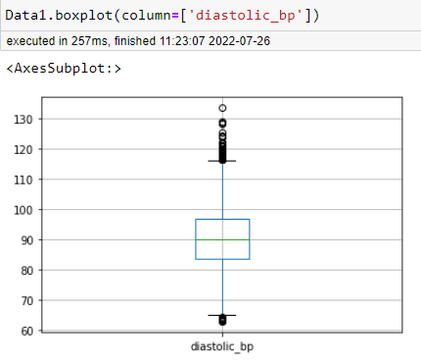
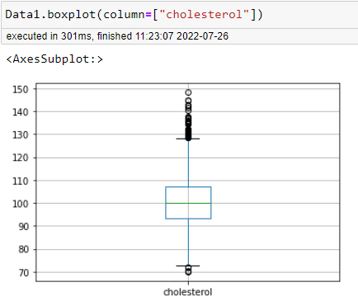
Histogram and Boxplot:
Systolic bp
Diastolic bp
Cholesterol
Systolic bp
Diastolic bp
Cholesterol

Slide 8
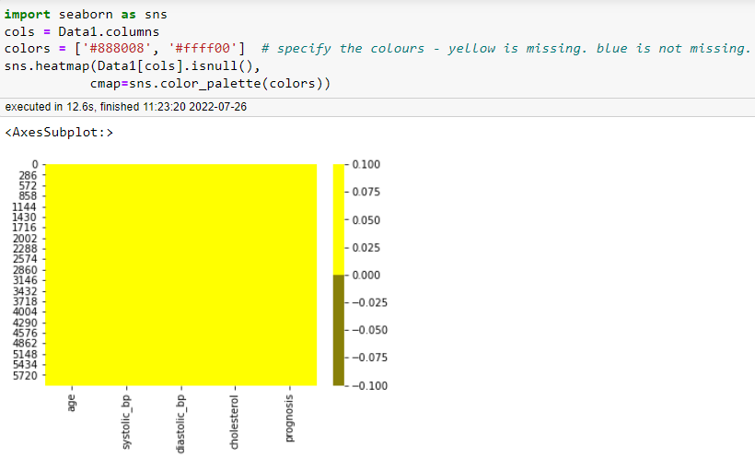
Seaborn Chart From seaborn chart we can say that there is no missing value in our data

Slide 9
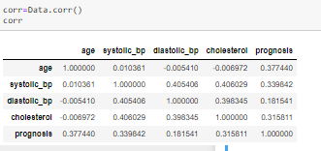
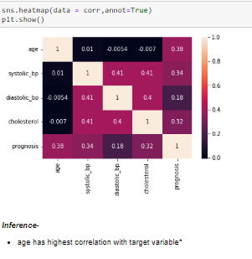
Correlation of Data

Slide 10
4. Project Highlight
Model | Overall Accuracy Train | Overall Accuracy Test
Logistic Regression | 74.14 | 72.44
Gaussian Naive Bayes Classifier | 73.4 | 72.77
Support Vector Machine | 74.04 | 72.55
XGboost Classifier | 94.42 | 70.05
Random Forest | 100 | 70.61
Decision Tree | 100 | 64.11
KNN | 83.02 | 67.11
Gradient Boosting Classifier | 77.22 | 74.83
Importing Data
EDA
Data Visualization
Handling Outliers with Median
Auto EDA
Feature Scaling
Tpot and PyCaret (AutoML)
Model Building
Logistic Regression
Gaussian Naive Bayes Classifier
Support Vector Machine
XGboost Classifier
Random Forest
Decision Tree
KNN
Gradient Boosting Classifier
Creation of pickle file of best fitted model (Gradient Boosting Classifier)
Deployment of model using Streamlit

Slide 11
Models Used for Model Building
Sr. No. | Model | Overall Accuracy Train | Overall Accuracy Test | Precisions |  | Recall |  | F1 Score |  | Testing sample
 |  |  |  | retinopathy | non-retinopathy | retinopathy | non-retinopathy | retinopathy | non-retinopathy
1 | Logistic Regression | 74.14 | 72.44 | 0.74 | 0.71 | 0.73 | 0.72 | 0.73 | 0.72 | 1800
2 | Gaussian Naive Bayes Classifier | 73.4 | 72.77 | 0.74 | 0.71 | 0.72 | 0.73 | 0.73 | 0.72 | 1800
3 | Support Vector Machine | 74.04 | 72.55 | 0.74 | 0.71 | 0.73 | 0.72 | 0.73 | 0.72 | 1800
4 | XGboost Classifier | 94.42 | 70.05 | 0.7 | 0.7 | 0.73 | 0.67 | 0.71 | 0.68 | 1800
5 | Random Forest | 100 | 70.61 | 0.71 | 0.7 | 0.73 | 0.68 | 0.72 | 0.69 | 1800
6 | Decision Tree | 100 | 64.11 | 0.66 | 0.62 | 0.64 | 0.64 | 0.63 | 0.63 | 1800
7 | KNN | 83.02 | 67.11 | 0.68 | 0.66 | 0.69 | 0.65 | 0.68 | 0.66 | 1800
8 | Gradient Boosting Classifier | 77.22 | 74.83 | 0.75 | 0.75 | 0.77 | 0.73 | 0.76 | 0.74 | 1200

Slide 12
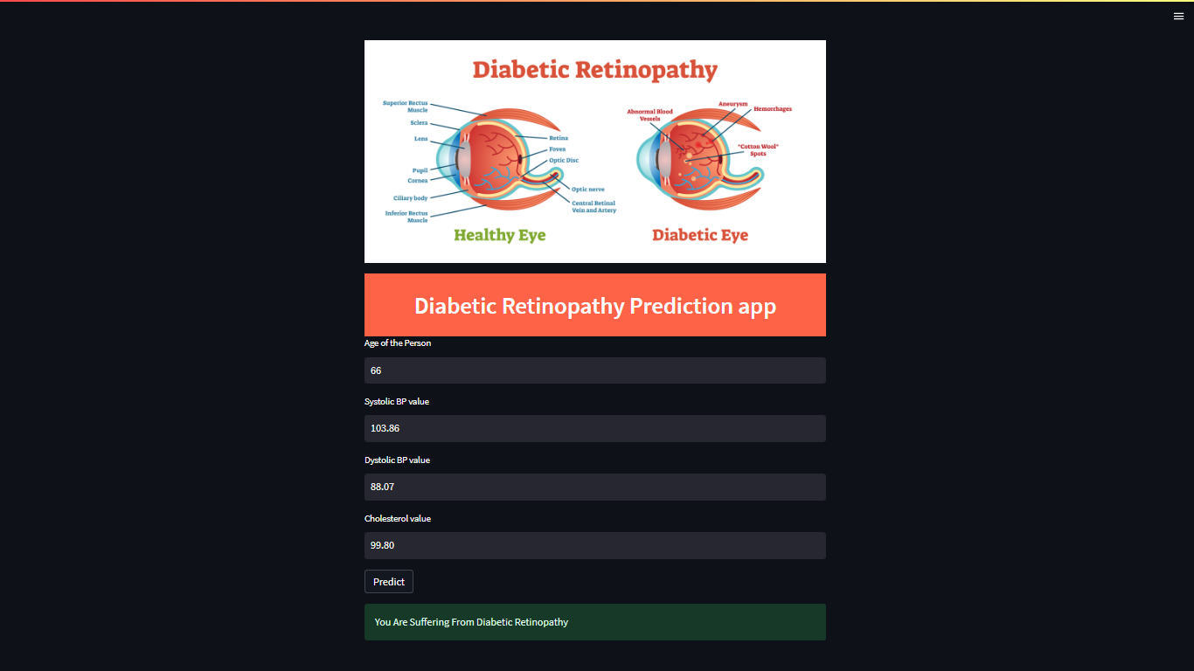
5. Deployment Result for Diabetic Retinopathy

Slide 13
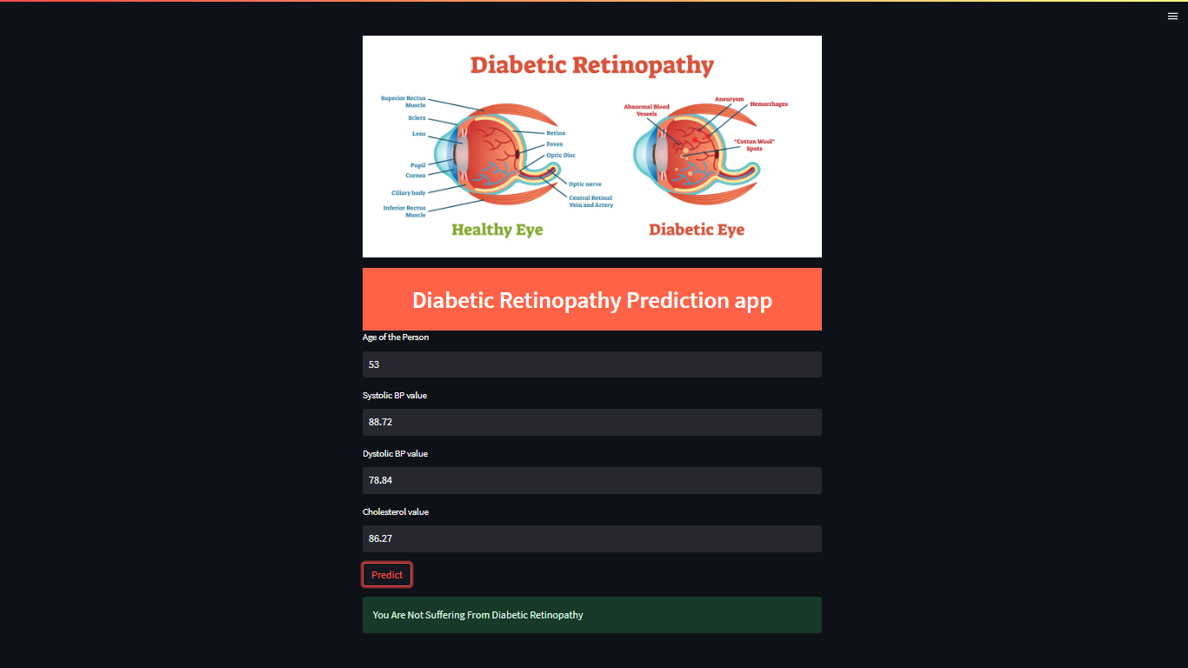
5. Deployment Result for Non-Diabetic Retinopathy

